Slide 1
Cloud Concepts – SaaS –M365
M365 – MS 100

Slide 2

Cloud computing
Delivery of computing service – including Server, Storage, database, network, software, analytics, and intelligence – over the internet.
You pay only for cloud service you use
Lower cost
More efficient
Flexible resources

Slide 3
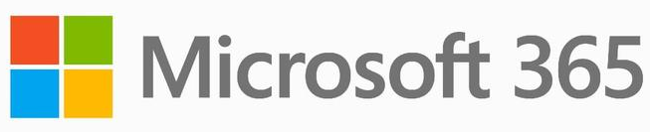
Computing concepts
Ex: Local Server
Ex: Cloud VM
Ex: Webhosting
You consume
Application
Application
Application
Application
You manage
Data
Data
Data
Data
You manage
Runtime
Runtime
Runtime
Runtime
Middleware
Middleware
Middleware
Middleware
You manage
Other Manage
O/S
O/S
O/S
O/S
Virtualization
Virtualization
Virtualization
Other Manage
Virtualization
Servers
Servers
Servers
Servers
Other Manage
Storage
Storage
Storage
Storage
Networking
Networking
Networking
Networking
On-premises
IaaS
PaaS
SaaS

Slide 4
Cloud Model SaaS : M365
A true digital workspace & more to come
M365 is a SaaS solution for Digital Workspace
Collaboration & sharing
Subscription based
M365 Suite integrate with Office365, SharePoint, Outlook & Dynamics365 etc..
Cloud only features
Notes:
https://blog.amplexor.com/microsoft-office-365-as-a-saas-solution-for-the-digital-workplace

Slide 5
Next Video
Summary
Cloud concepts and SaaS
history of Office365 & Microsoft 365

